Slide 1
Literary Criticism (BA-TY)
Dr. Nirmala S. Padmavat
Director, IQAC
Nutan Mahavidyalaya, Selu

Slide 2
John Dryden
Early Life and Literary Work: John Dryden, an influential English poet, playwright, and literary critic, lived from 1631 to 1700. John Dryden was born on August 9, 1631, in Aldwincle, Northamptonshire, England. He was raised in a Puritan family, and his father died when he was young. Dryden received his early education at Westminster School and later attended Trinity College, Cambridge, where he studied under the guidance of renowned scholars.

Slide 3
Literary Work
Dryden is considered one of the most significant literary figures of the Restoration period (late 17th century). His first major literary success came with the poem "Heroic Stanzas" (1659), a eulogy on the death of Oliver Cromwell. In the early years of his career, Dryden wrote various poems, including satires, epistles, and heroic couplets. He was also involved in writing plays, contributing to the development of the Restoration comedy and heroic drama.

Slide 4
Notable Works
"Annus Mirabilis" (1667): A historical poem that celebrated the events of the year 1666, including the Great Fire of London and the English victory over the Dutch in the Second Anglo-Dutch War.
"Absalom and Achitophel" (1681): A satirical poem that allegorically addresses the Exclusion Crisis, a political conflict over the succession to the English throne.
"Mac Flecknoe" (1682): A satirical mock-heroic poem that lampoons another poet, Thomas Shadwell, and his literary works.
"All for Love" (1678): A tragedy based on the story of Antony and Cleopatra, showcasing Dryden's mastery of blank verse and dramatic expression.

Slide 5
Literary Criticism
Dryden was an influential literary critic and essayist. His critical essays were often written in the form of prefaces to his own works or those of other authors. He defended and popularized the use of heroic couplets in English poetry, which became a dominant verse form in the 18th century. In his essay "An Essay of Dramatic Poesie" (1668), Dryden presents a lively discussion about the merits of various dramatic forms and defends the value of English drama against French neoclassical ideals.

Slide 6
Poet Laureate and Later Life
Dryden was appointed as the Poet Laureate of England in 1668, a position he held until his death in 1700. During the Glorious Revolution of 1688, Dryden's loyalty to the Stuart monarchy led to a decline in his political influence and financial struggles. He continued to write poetry, translations, and literary criticism throughout his later life.

Slide 7
Legacy
John Dryden's works had a profound impact on the literary landscape of his time and the following century. His contribution to English poetry, drama, and literary criticism helped shape the course of English literature during the Restoration period and beyond. Dryden's heroic couplets and his mastery of satire and political allegory influenced many later poets, including Alexander Pope and Samuel Johnson. One of his most notable works on literary criticism is "An Essay of Dramatic Poesy," also known as "Of Dramatic Poesie," published in 1668. In this essay, Dryden engages in a lively dialogue between four characters who discuss the merits and challenges of various dramatic forms. Here are some key points from Dryden's literary criticism:

Slide 8
Neoclassicism and the Three Unities
Dryden was a proponent of Neoclassical principles, which emphasized adherence to the rules of Aristotle's Poetics. He advocated for the unity of action, time, and place in drama, believing that plays should have a single, coherent plot, take place within a 24-hour period, and occur in a single location.

Slide 9
Verisimilitude and Decorum
Dryden stressed the importance of verisimilitude, or the appearance of truth, in drama. He believed that characters and actions should be consistent and plausible, adhering to the principles of decorum, where characters' behavior should align with their social status and context.

Slide 10
Judgment and Taste
Dryden argued that literary criticism required a cultivated sense of judgment and taste. He believed that a critic should have a comprehensive understanding of literature, rhetoric, and human nature to make sound assessments of literary works.

Slide 11
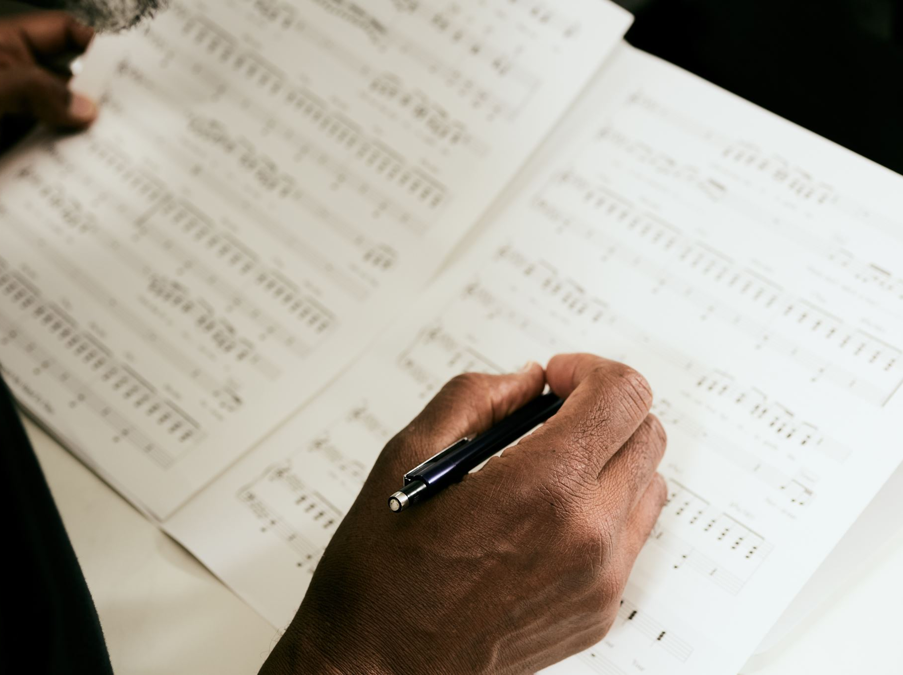
Comparative Analysis
In "An Essay of Dramatic Poesy," Dryden uses comparative analysis to evaluate various dramatic forms, including ancient Greek drama and the contemporary French and English plays. He discusses the strengths and weaknesses of each form, highlighting their distinct qualities.

Slide 12
Favoring Shakespeare
Dryden expressed his admiration for William Shakespeare and praised his plays for their imaginative depth, rich characterization, and universal appeal. He considered Shakespeare to be the greatest playwright and poet in the English language.

Slide 13
The Role of the Poet and Playwright
Dryden saw the poet and playwright as important figures in society, possessing the ability to influence and entertain the audience while also conveying moral and philosophical ideas. He believed that poets should combine creative imagination with skillful craftsmanship.

Slide 14
Unity of Design
Dryden advocated for a clear and unified design in literary works. He criticized plays that lacked coherence or meandered through various subplots without a central focus.

Slide 15
Satire and Critique
Dryden was known for his satirical works, and he used satire as a means of social and political critique. His criticism often targeted contemporary writers and social customs, seeking to provoke reflection and change.

Slide 16
Conclusion
John Dryden's literary criticism, particularly his advocacy for neoclassical principles, his appreciation of Shakespeare, and his focus on verisimilitude and decorum, had a lasting impact on English literature and drama. His essays and prefaces contributed to the development of literary theory during the Restoration period and influenced subsequent generations of writers and critics.

Slide 17
Thank you!

